Slide 1
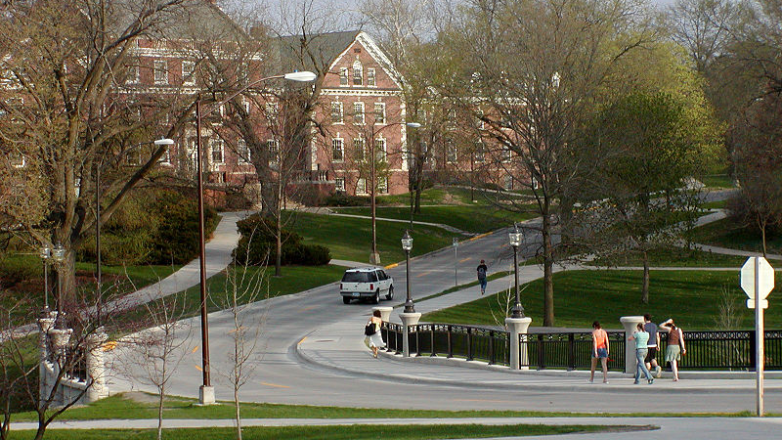
Housing market in Aimes, Iowa
Investing in real estate for students

Slide 2
Approach
Preliminary visualizations and missing value imputation
Add location variables
Train a few tree-based models to discover key features found by these models
Attempt to use these features for linear regression, then train a regularized linear regression model (decide not to use it because of concerns regarding assumption violations)
Blend the tree-based models to make final predictions (R^2=.932, much higher before duplicate removal)
Calculate cap rate based on real estate studies
Build and deploy an app to help real estate investors

Slide 3
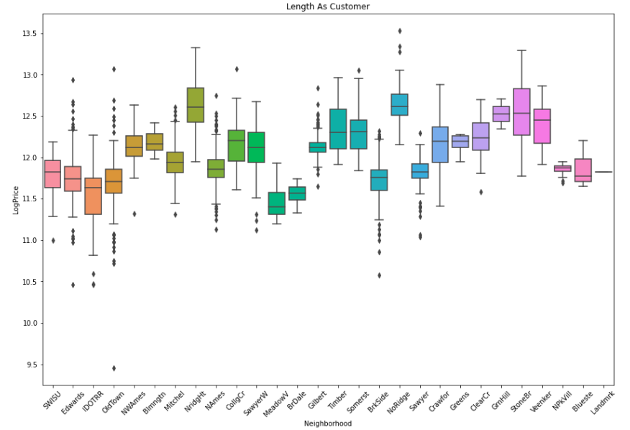

Slide 4
RFs (R2: .907 on Test Set) | XGBoost (R2: 0.93174/.95(dupl) on Test Set) | CatBoost (R2:0.92275 (no dupl)/ 0.95 (dupl) on Test Set)
OverallQual 0.555752 GrLivArea 0.138248 1stFlrSF 0.051820 TotalBsmtSF 0.030623 GarageArea 0.028397 BsmtFinSF1 0.024851 LotArea 0.011924 2ndFlrSF 0.011556 FullBath 0.011551 GarageCars 0.009987 YearBuilt 0.008160 MasVnrArea 0.006633 YearRemodAdd 0.006391 lats 0.005636 LotFrontage 0.005449 KitchenQual 0.005060 longs 0.005030 OverallCond 0.004534 BsmtUnfSF 0.004444 GarageFinish 0.004428 OpenPorchSF 0.004421 BsmtQual 0.003991 GarageYrBlt 0.003732 WoodDeckSF 0.003598 Neighborhood 0.003595 MSZoning 0.003421 Fireplaces 0.003395 MoSold 0.003094 GarageType 0.002800 TotRmsAbvGrd 0.002783 FireplaceQu 0.002555 ExterQual 0.002511 BsmtFullBath 0.002301 ScreenPorch 0.002116 BsmtFinType1 0.001919 HeatingQC 0.001669 YrSold 0.001313 MSSubClass 0.001256 CentralAir 0.001201 Exterior1st 0.001199 | OverallQual 0.227648 ExterQual 0.200002 GarageCars 0.161469 KitchenQual 0.053119 BsmtQual 0.040191 GrLivArea 0.029050 Fireplaces 0.024213 YearBuilt 0.022945 CentralAir 0.015570 FullBath 0.015364 GarageArea 0.013840 GarageFinish 0.013713 1stFlrSF 0.013117 TotalBsmtSF 0.012377 GarageType 0.012039 MissingLoc 0.010694 BsmtFinSF1 0.009349 MSZoning 0.007960 OverallCond 0.007506 2ndFlrSF 0.006749 YearRemodAdd 0.005971 PavedDrive 0.005873 FireplaceQu 0.005541 Condition2 0.005395 MasVnrArea 0.004357 SaleCondition 0.003938 BsmtFullBath 0.003911 LotArea 0.003658 HalfBath 0.003644 BsmtFinType1 0.003463 ScreenPorch 0.003071 LandContour 0.003058 Neighborhood 0.002877 BsmtExposure 0.002653 HeatingQC 0.002649 BedroomAbvGr 0.002311 Functional 0.002297 RoofMatl 0.002271 KitchenAbvGr 0.002001 GarageYrBlt 0.001883 Condition1 0.001717 WoodDeckSF 0.001531 | OverallQual 18.754183 GrLivArea 15.497276 1stFlrSF 5.126514 TotalBsmtSF 4.201394 BsmtFinSF1 4.047372 KitchenQual 3.025626 Fireplaces 2.791535 LotArea 2.785231 GarageArea 2.626287 2ndFlrSF 2.542275 YearBuilt 2.440147 GarageCars 2.183048 YearRemodAdd 2.048334 OverallCond 1.775863 BsmtQual 1.716422 ExterQual 1.515279 GarageType 1.418953 FullBath 1.385398 GarageYrBlt 1.384613 HalfBath 1.312559 GarageFinish 1.296044 MasVnrArea 1.065487 lats 1.027604 BsmtFullBath 0.957149 FireplaceQu 0.952344 Neighborhood 0.922058 BsmtExposure 0.901652 OpenPorchSF 0.879730 BsmtFinType1 0.824832 TotRmsAbvGrd 0.807216 HeatingQC 0.780435 LotFrontage 0.667464 WoodDeckSF 0.666440 LandContour 0.647740 MoSold 0.564950 LotShape 0.506125 SaleCondition 0.495362 BldgType 0.490626 ScreenPorch 0.457204 MSZoning 0.439558 CentralAir 0.422234 longs 0.393207 Condition1 0.375902 BsmtUnfSF 0.332632 MSSubClass 0.301711 BedroomAbvGr 0.283189 Exterior2nd 0.276977 LotConfig 0.274274 SaleType 0.259751 HouseStyle 0.255075 RoofStyle 0.252625 PavedDrive 0.250240 Foundation 0.227264 YrSold 0.214335 Exterior1st 0.207251 MissingLoc 0.206376 RoofMatl 0.194395 ExterCond 0.186038

Slide 5
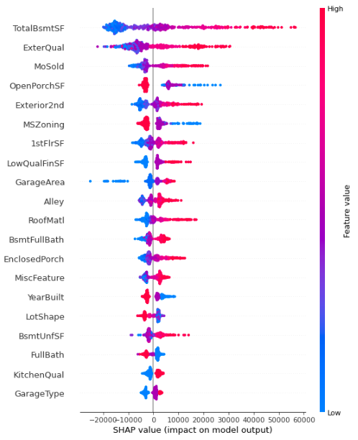
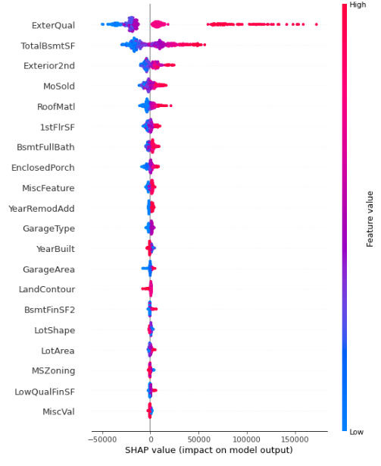
rfs, xgb,Catboost shap values

Slide 6
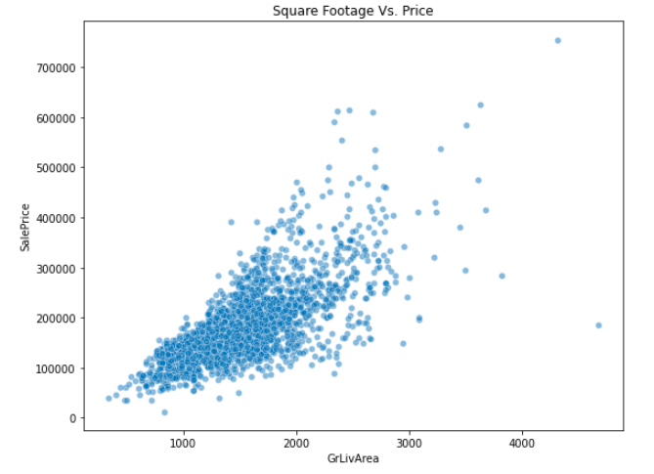
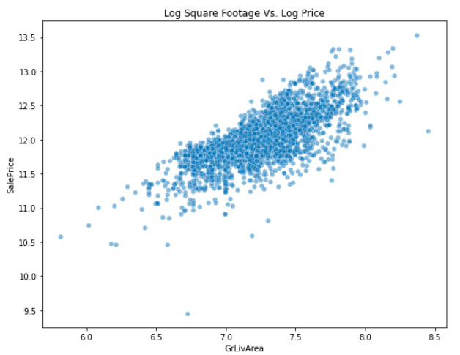
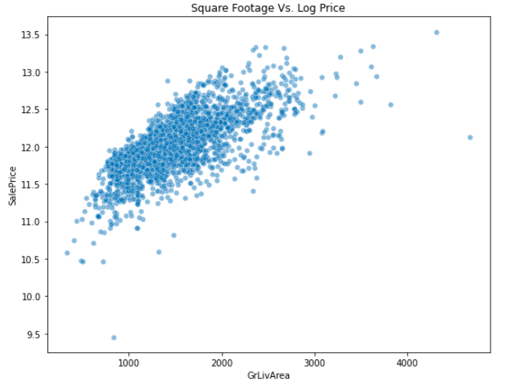
Transform the price for linear model
Transforming the independent variable with log is useful to reduce the spread
Smaller houses are more expensive by square foot

Slide 7
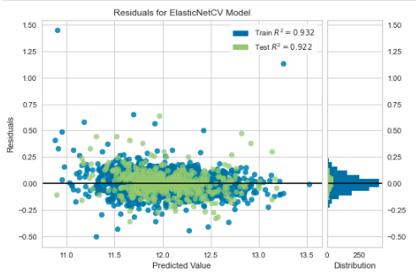
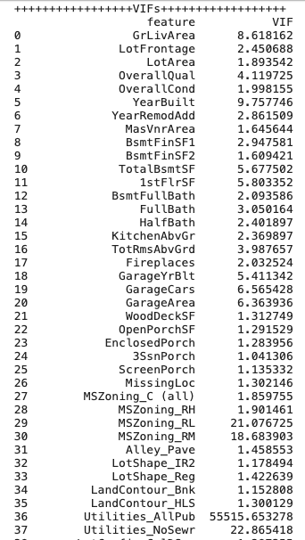
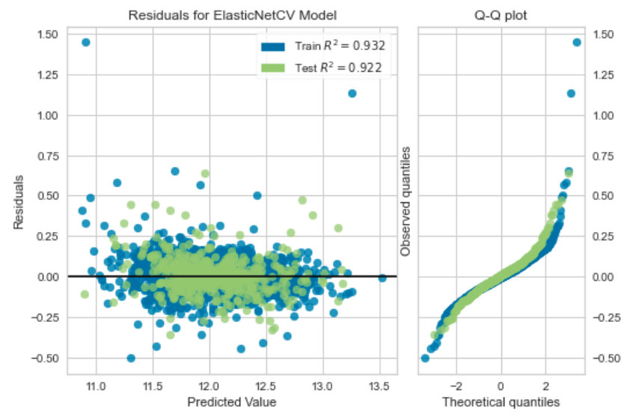
A case against linear regression
The results are for the ElasticNet regression for all features
Over half of the features get dropped, yet multicollinearity persists according to VIFs
When variables such as Utilities_AllPub are dropped, VIFs for other nonrelated variables expand
Residuals deviate from the straight line of the Q-Q plot away from the center

Slide 8
Performance Comparisons
CatBoost performance RMSE: 18476.49 R2: 0.95

Slide 9
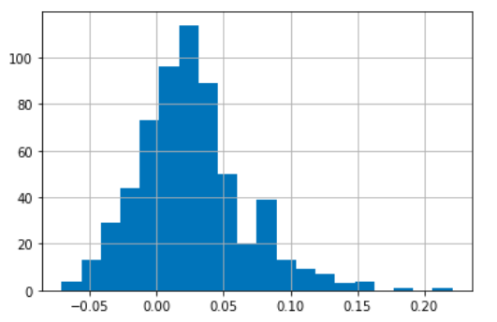
To do
Consult with real estate professionals before using the model in production
Distribution of returns is consistent with average returns on student housing being in the range between 7 and 18%
https://www.bbc.com/worklife/article/20160420-making-money-from-students,

Slide 10
Cap rate calculations
costs_per_year=(.015+.02+.006+.03)
new_df['noi']=new_df['dist_premium']*(450*12*new_df['BedroomAbvGr_x']*(1-new_df['vac_rate']))-new_df['preds']*costs_per_year
new_df['cap_rate']=new_df['noi']/new_df['preds’]
Condition, neighborhood, and other information is embedded in the predictions
More details and full code in the Appendix

Slide 11

Appendix

Slide 12
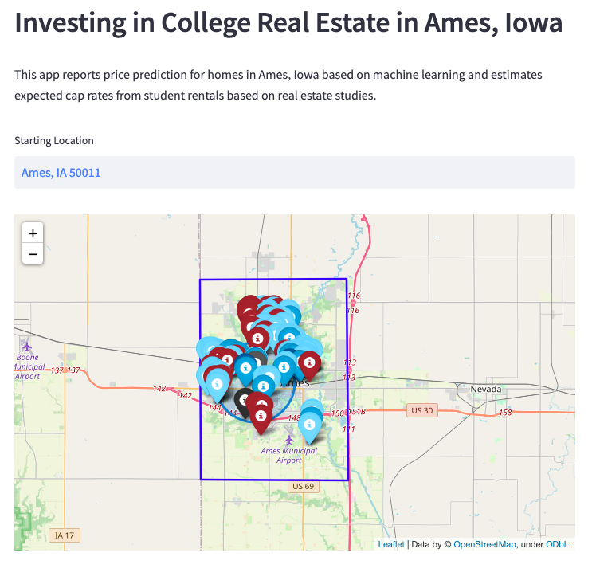
Investment helper Web app
Deployed at https://ames-app.herokuapp.com/
20% subsampled from the test set to reduce clutter
Predictions and locations stored in a data frame to reduce latency
Most lucrative real estate is often located closer to campus

Slide 13
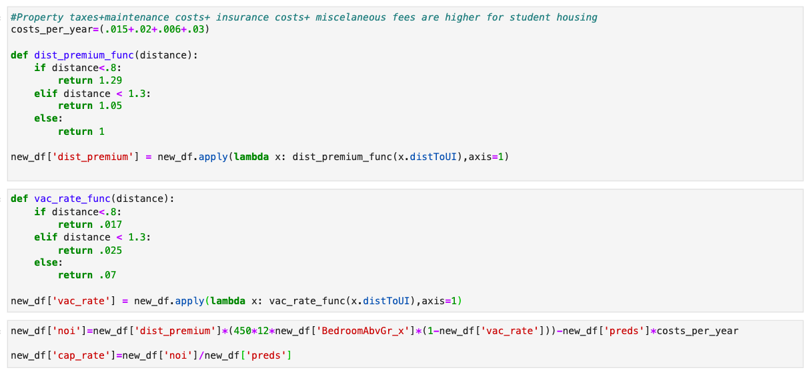
CAP rate calculation details

Slide 14
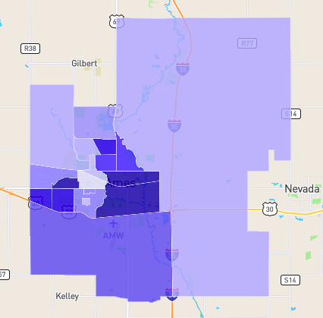

Slide 15
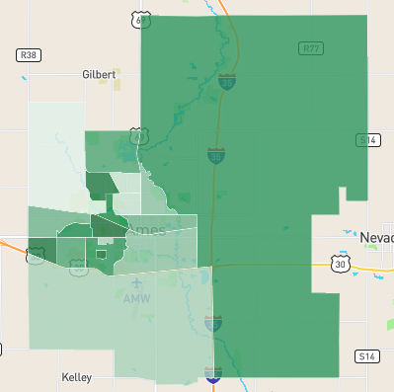

Slide 16
Future work
Consult with real estate agents regarding refining the NOI and cap rate calculations
Perform a more detailed neighborhood analysis

Slide 17
REsources
How to calculate NOI:
https://www.investopedia.com/terms/n/noi.asp
How to calculate cap rate using NOI:
https://www.investopedia.com/terms/c/capitalizationrate.asp
Renting houses in Ames, Iowa (approximately $500/room):
https://www.zillow.com/ames-ia/rent-houses/
Proximity to campus and rent premium growth:
https://www.realpage.com/analytics/top-performing-student-housing-trending-closer-campus/

Slide 18
REsources
Vacancy rate data:
https://www.statista.com/statistics/913457/vacancy-rate-student-housing-units-usa/ and
https://www.neighborhoodscout.com/ia/ames/real-estate
Insurance data:
https://www.bankrate.com/insurance/homeowners-insurance/iowa/
Premium based on distance from campus estimated using https://www.statista.com/statistics/1281943/rent-of-student-housing-by-distance-from-campus/

